Slide 1
Synthetic Control modelling
Victor Yu, Senior Public Health Analyst, Hertfordshire County Council
NHS-R Conference 2021 | 2022-01 | PH.Intelligence@hertfordshire.gov.uk

Slide 2
Day Plan
9:30-10:30 Presentation
10:30-11:30 Start on practical
11:30-11:40 Light Break
11:40-12:30 Practical
12:30-13:15 Lunch
13:15-15:45 Practical
15:45-16:00 Final thoughts

Slide 3
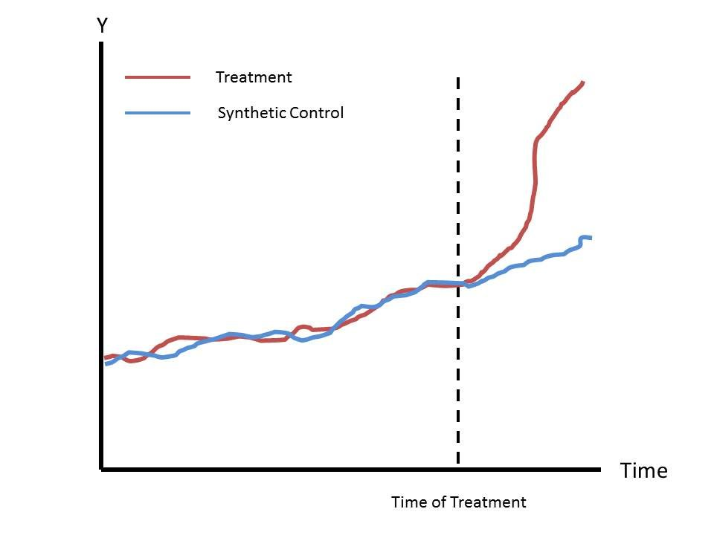
Introduction – background
How do we measure the effects of interventions/treatment?
Many interventions cannot be evaluated through RCTs, and rely on the assessment of observational data.
Previous techniques include interrupted-time series, panel based regression, instrumental variables
But these lack..

Slide 4
Introduction – what are synthetic controls?
A increasingly popular modelling technique, frequently done for evaluation of interventions on a “treated unit” in case studies
Uses aggregate, observational level data
Constructing a ‘synthetic’ control unit that represents a weighted combination of many untreated units from a ‘donor pool’ before the intervention takes place, in terms of predictor covariates and/or outcomes
This is done through numerical optimisation procedures
This synthetic control units acts as a “counterfactual”
The effect of the intervention can then be estimated by comparing differences in the treated and synthetic time series
Notes:
originally introduced for economic studies, but now used in a wide range of fields from healthcare, to politics
Aggregated level data
3) This synthetic control unit is similar to similar as possible to that of the treated unit, in terms of predictor covariates and outcomes
Traditional regression analysis techniques require large samples and many observed instances of the event or intervention of interest and, as a result, they are often ill-suited to estimate the effects of infrequent events, such as policy interventions, on aggregate units
Economists have approached the estimation of the effects of large-scale but infrequent interventions using time-series analysis and comparative case studies. Single-unit time-series analysis is an effective tool to study the short-term effects of policy interventions in cases when we expect short-term effects to be of a substantial magnitude.2 However, the use of time-series techniques to estimate medium and long-term effects of policy intervention is complicated by the presence of shocks to the outcome of interest, aside from the effect of the intervention.
Comparative case studies involve explicit, formal, and structured focus on comparison to produce causal inferences about social phenomena. And are based on the idea that the effect of an intervention can be inferred by comparing the evolution of the outcome variables of interest, between the unit exposed to treatment and a group of units that are similar to the exposed unit but were not affected by the treatment.
A drawback of comparative case studies of this type is that the selection of the comparison units is not formalized and often relies on informal statements of affinity between the units affected by the event or intervention of interest and a set of comparison units. Moreover, when the units of observation are a small number of aggregate entities, like countries or regions, no single unit alone may provide a good comparison for the unit affected by the intervention.
So, the synthetic control method is based on the idea that, when the units of observation are a small number of aggregate entities, a combination of unaffected units often provides a more appropriate comparison than any single unaffected unit alone. The synthetic control methodology formalizes the selection of the comparison units using a data driven procedure, and it’s this formalization also opens the door to a mode of quantitative inference.

Slide 5


Toy example – context
1988 – California introduces Proposition 99
Additional excise tax on cigarettes amounting to 25 cents for each pack of 20 cigarettes
Tax revenues going to health and anti-smoking education budgets, media campaigns, stimulated local clean air ordinances
How can we measure the tax’s effect on reduced smoking rates /per-capita cigarette sales?

Slide 6
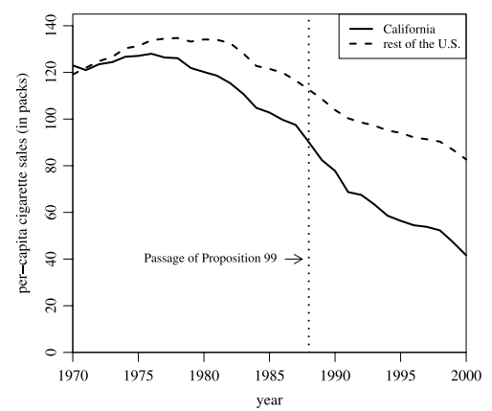
Toy example – intro to method
Abadie et al.* (2010) applied the SC method
Used annual state-level panel data for the period 1970–2000
Created a “synthetic” California, composed of a weighted average of 38 potential control states
Weights based on values of predictors of cigarette consumption in California before the passage of Proposition 99

Slide 7
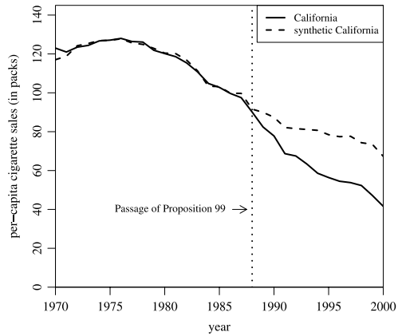
Introduction – toy example
Estimated the effect between California and its synthetic versions in the years after Proposition 99 was passed
Demonstrated that passage of the Act markedly reduced tobacco consumption
Estimated that by 2000, annual per-capita cigarette sales 26 packs lower compared to the ‘synthetic’ region
Notes:
An optimisation procedure using the outcome variables from the potential control areas and any other predictor variables identified (see box 2) selects the best weighting of units from the donor pool to create a synthetic control. The optimisation procedure minimises the difference between the outcome of interest in the treated unit in the preintervention period and the synthetic control. The difference is measured by the root mean square prediction error (RMSPE).

Slide 8
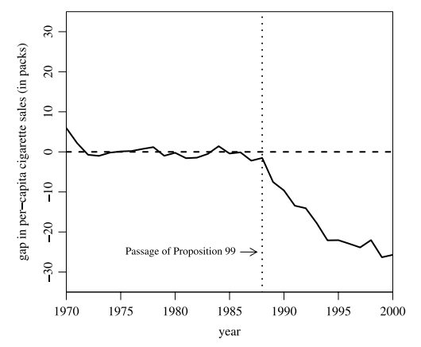

Introduction – toy example
Estimate the effect between California and its synthetic versions in the years after Proposition 99 was passed
Demonstrated that passage of the Act markedly reduced tobacco consumption
Estimated that by 2000, annual per-capita cigarette sales 26 packs lower compared to the ‘synthetic’ region
Notes:
An optimisation procedure using the outcome variables from the potential control areas and any other predictor variables identified (see box 2) selects the best weighting of units from the donor pool to create a synthetic control. The optimisation procedure minimises the difference between the outcome of interest in the treated unit in the preintervention period and the synthetic control. The difference is measured by the root mean square prediction error (RMSPE).

Slide 9
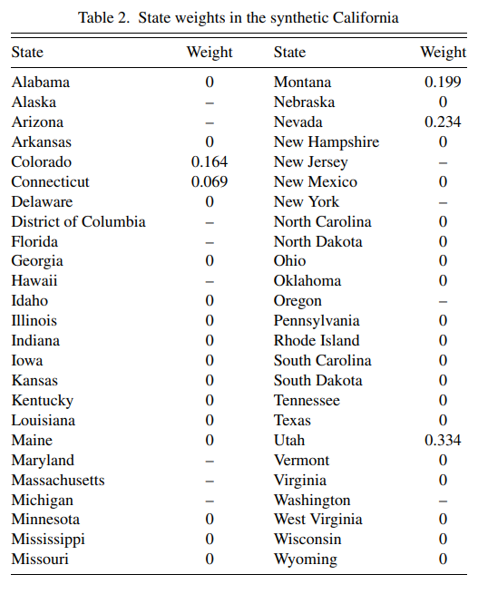
Introduction – toy example
Estimate the effect between California and its synthetic versions in the years after Proposition 99 was passed
Demonstrated that passage of the Act markedly reduced tobacco consumption
Estimated that by 2000, annual per-capita cigarette sales 26 packs lower compared to the ‘synthetic’ region
Notes:
An optimisation procedure using the outcome variables from the potential control areas and any other predictor variables identified (see box 2) selects the best weighting of units from the donor pool to create a synthetic control. The optimisation procedure minimises the difference between the outcome of interest in the treated unit in the preintervention period and the synthetic control. The difference is measured by the root mean square prediction error (RMSPE).
The weights applied to different states are based on those that minimise the difference (based on achieving the smallest root mean square prediction error).

Slide 10
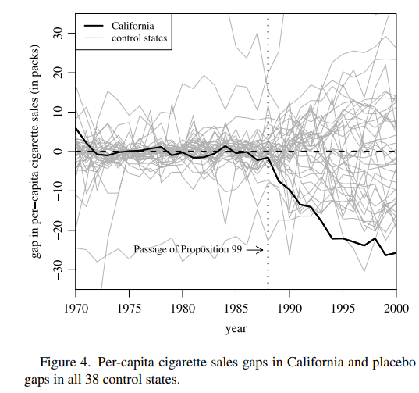
Introduction – toy example
How to test for significance for estimates?
Run placebo studies by applying the synthetic control method to states that did not implement a largescale tobacco control program during the same time period
Through ‘placebo studies’, can confirm that estimated effects for California are unusually large relative to the distribution of the estimate that is obtained when we apply the same analysis to the states in the donor pool.
Notes:
. If the placebo studies create gaps of magnitude similar to the one estimated for California, then our interpretation is that our analysis does not provide significant evidence of a negative effect of Proposition 99 on cigarette sales in California. If, on the other hand, the placebo studies show that the gap estimated for California is unusually large relative to the gaps for the states that did not implement large-scale tobacco control program, then our interpretation is that our analysis provides significant evidence of a negative effect of Proposition 99 on cigarette sales in California.
Fitting based on MSPE
New Hampshire is the state with the highest per capita cigarette sales for every year prior to the passage of Proposition 99. Therefore, there is no combination of states in our sample that can reproduce the time series of per capita cigarette sales in New Hampshire prior to 1988. Similar problems arise for other states with extreme values of per capita cigarette sales during the pre-Proposition 99 period.

Slide 11
Introduction – toy example
Remove placebo runs with poor pre-intervention fit
Arbitrary, but often 2x/5x MSPE of the ‘treated’ unit’s pre-intervention period used
Notes:
. If the placebo studies create gaps of magnitude similar to the one estimated for California, then our interpretation is that our analysis does not provide significant evidence of a negative effect of Proposition 99 on cigarette sales in California. If, on the other hand, the placebo studies show that the gap estimated for California is unusually large relative to the gaps for the states that did not implement large-scale tobacco control program, then our interpretation is that our analysis provides significant evidence of a negative effect of Proposition 99 on cigarette sales in California.
Fitting based on MSPE
New Hampshire is the state with the highest per capita cigarette sales for every year prior to the passage of Proposition 99. Therefore, there is no combination of states in our sample that can reproduce the time series of per capita cigarette sales in New Hampshire prior to 1988. Similar problems arise for other states with extreme values of per capita cigarette sales during the pre-Proposition 99 period.

Slide 12
Why use synthetic controls?
No extrapolation - synthetic control weights are nonnegative and sum to one.
Transparency of the fit – can see the extent observations in the donor pool can approximate the characteristics of the treated units by interpolation. Can see weights and average outcomes, and see whether SC would be appropriate or not.
Notes:
With regular panel data, can easily fit a linear regression model through creating a dummy variable for the time period pre and post-intervention. It is easy to check that, like their synthetic control counterparts, the regression weights in Wreg sum to one. however, regression weights may be outside the [0, 1] interval, allowing extrapolation outside of the support of the data

Slide 13
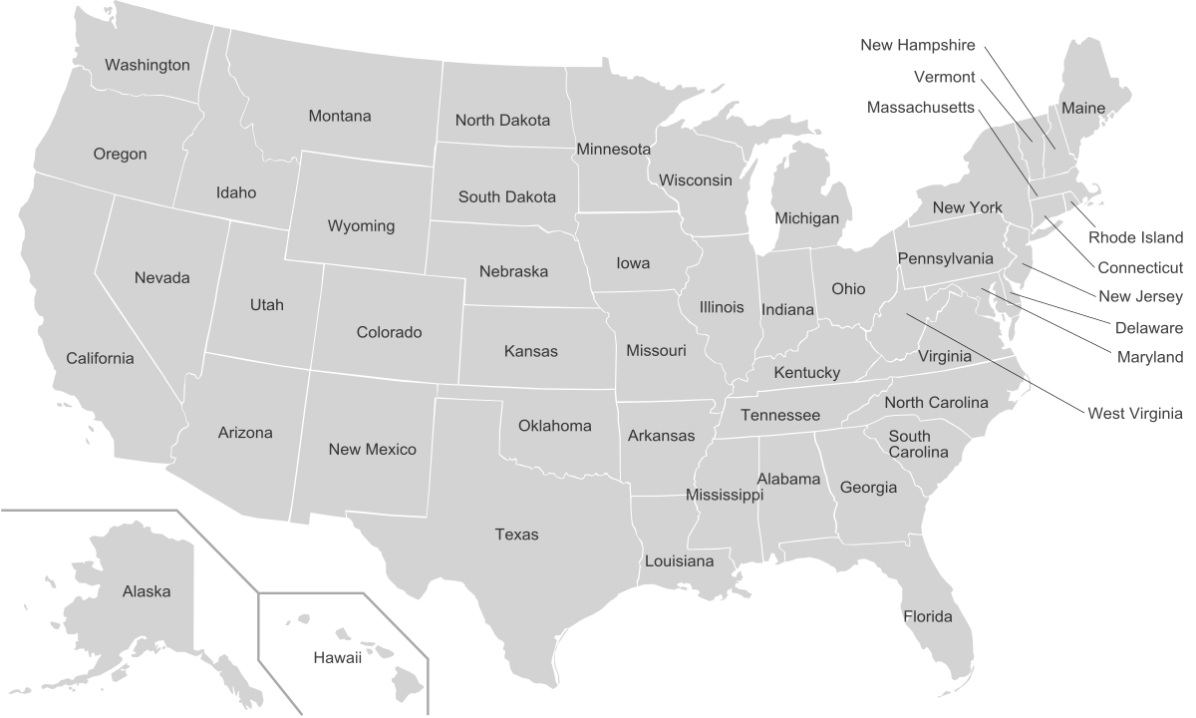
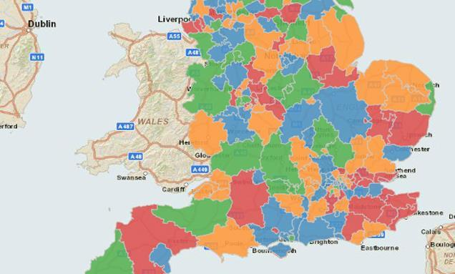
Advantages
Very well suited to geographical/administrative units
Secondary and observational data orientated
Many packages available on different platforms
Accounts for unmeasured time-varying confounders
Can assess accuracy via placebo testing
Notes:
Units or entities.. which allow us to select appropriate comparison units to use as the “counterfactual”
As well, for geographical divisions, secondary data will be commonly available, we won’t need to collect data ourselves specifically for the analysis
Many packages available for whatever problem.. Of course R today, but also available for Python, STATA for example
As this builds upon DiD approaches, we can account for the time-varying effects of confounders as we don’t need select a specific counterfactual or comparator unit, a priori

Slide 14
Contextual Requirements
Understanding of the intervention. Five Ws, 1 H
Size of the effect
Low volatility of the outcome variables
Availability of a comparison group:
Units in donor pool shouldn’t have adopted similar interventions to one under investigation during time period of data
Similar characteristics (defined a priori) to the ‘treated’ unit to avoid interpolation biases
No ‘spillover’ effect from the intervention in the ‘treated’ unit to other units
“Validity of synthetic control estimators depends on important practical requirements. Perfunctory applications that ignore the context of the empirical investigation and the characteristics of the data may miss the mark, producing misleading estimates.” - Alberto Abadie
Notes:
You need a well developed understanding behind the intervention and it’s context. Without a fundamental understanding of what the intervention is for, there’s no point in conducting the study at all.
As previously discussed, the goal of comparative case studies is to estimate the effect of a policy intervention on the unit (e.g., state or region) exposed to an intervention of interest. That is, comparative case studies typically estimate the effect of an intervention on a single treated unit or on a small number of treated units.
The nature of this exercise indicates that small effects will be indistinguishable from other shocks to the outcome of the affected unit, especially if the outcome variable of interest is highly volatile.
As a result, the impact of “small” interventions with effects of a magnitude similar to the volatility of the outcome are difficult to detect.
Outcome variables that include substantial random noise elevate the risk of over-fitting, as explained in subsection 3.3. In cases where substantial volatility is present in the outcome of interest it is advisable to remove it via filtering, in both the exposed unit as well as in the units in the donor pool, before applying synthetic control techniques.1
Units that adopt an intervention similar to the one adopted by the unit of interest should not be included in the donor pool because they are affected by the intervention, very much like the unit of interest

Slide 15
Data Requirements
Aggregate Data on Predictors and Outcomes for the ‘treated’ and comparison units
Sufficient pre-intervention data:
Enough time points to track the pre-intervention period
Sufficient post-intervention data:
Relevant outcomes
Notes:
synthetic control method requires the availability of data on outcomes and predictors of the outcome for the unit or units exposed to the intervention of interest and a set of comparison units
State level cigarette consumption statistics in the United States
Sometimes, when aggregate data do not exist, aggregates of micro-data are employed in comparative case studies
Credibility of a synthetic control estimator depends in great part on its ability to steadily track the trajectory of the outcome variable for the treated unit before the intervention.
Therefore, when designing a synthetic control study, it is of to collect information on the affected unit and the donor pool for a large pre-intervention window.
Because With a small number of pre-intervention periods, a close or even perfect fit of the predictor values for the treated unit can spuriously attained, in which case the resulting synthetic control may fail to reproduce the trajectory of the outcome for the treated unit in the absence of the intervention.
The evaluation data must include outcome measures that are possibly affected by the intervention and are relevant for the policy decision or scientific inquiry that is the object of the study. This may be problematic if the effect of an intervention is expected to arise gradually over time and if no forward-looking measures of the outcome are available. Conversely, in some practical instances, the effect of an intervention may dissipate rapidly after showing substantial effectiveness for a few initial periods. Extensive post-intervention information allows a more complete picture of the effects of the intervention, in time and across the various outcomes of interest.

Slide 16
Synthetic Controls with R
Several packages available
Synth
MSCMT
Gsynth
Microsynth
tidysynth
Notes:
Synth – First SC package developed back in 2014, but hasn’t been updated for a while, superceded by other packages
Gsynth – generalised version of SC, counterfactuals for each treated unit using control group information based on a linear interactive fixed effects model. And is package which we used for modelling VI programme talk about in a bit
Tidysynth – Builds on original Synth package using tidyverse principles

Slide 17
Synthetic Controls with R
Several packages available
Synth
MSMCT
Gsynth
Microsynth
tidysynth
Notes:
MSMCT - several variables of interest simultaneously and to treat explanatory variables as time series, rather then just taking the average value in the pre-intervention period
Gsynth – generalised version of SC, counterfactuals for each treated unit using control group information based on a linear interactive fixed effects model which incorporates unit-specific intercepts interacted with time-varying coefficients. This method generalizes the synthetic control method to the case of multiple treated units and variable treatment periods, and improves efficiency and interpretability. And is package which we used for modelling VI programme talk about in a bit. I would personally recommend this package if you’re modelling more than one treated unit.
Microsynth - incorporating high-dimensional, micro-level data into the SC framework. Better able to calculate weights that provide exact matches between treatment and synthetic control unit, both outcome and predictor variables.
Tidysynth – Builds on original Synth package using tidyverse principles. Improvements allow users to inspect, visualize, and tune the synthetic control more easily, and to allow you to model the whole workflow using pipes. If you’re a fan of pipes, then you’ll probably want to use this package more.

Slide 18

Synthetic Controls with R
Several packages available
Synth
MSCMT
Gsynth
Microsynth
tidysynth
Notes:
Gsynth – generalised version of SC, counterfactuals for each treated unit using control group information based on a linear interactive fixed effects model which incorporates unit-specific intercepts interacted with time-varying coefficients. This method generalizes the synthetic control method to the case of multiple treated units and variable treatment periods, and improves efficiency and interpretability. And is package which we used for modelling VI programme talk about in a bit. I would personally recommend this package if you’re modelling more than one treated unit.
Microsynth - incorporating high-dimensional, micro-level data into the SC framework. Better able to calculate weights that provide exact matches between treatment and synthetic control unit, both outcome and predictor variables.
Tidysynth – Builds on original Synth package using tidyverse principles. Improvements allow users to inspect, visualize, and tune the synthetic control more easily, and to allow you to model the whole workflow using pipes. If you’re a fan of pipes, then you’ll probably want to use this package more.

Slide 19
Example: Vertical Integration programme
Population: Royal Wolverhampton NHS Trust, practice population of 10 GP practices
Intervention: Vertical Integration Pilot Scheme
Comparator: Non-VI practices in Wolverhampton and adjacent CCGs
Outcome: 1) ED attendances 2) emergency admissions 3) re-admissions
Notes:
Developing new models of care in the PACS vanguards | The King's Fund (kingsfund.org.uk)
10 GP practices integrated directly within the Trust between 2015-2018
Represented centrepiece of NHS 5YFV back in 2014 – Primary and Acute Care Systems (PACS) new care model tested as part of Vanguard programmes

Slide 20
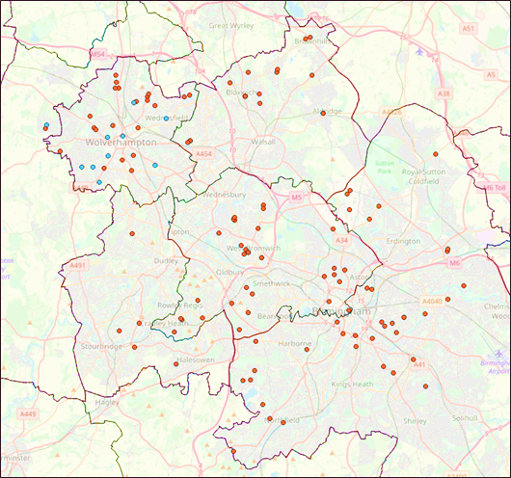
Example: Vertical Integration programme
Construct a “synthetic” version of each of the 10 GP practices
For each VI practice, a “synthetic” control practice is constructed from donor practices across adjacent CCGs
The Synthetic Control practice represents the counterfactual scenario for the VI practice, where the intervention of becoming vertically integrated is assumed to never have occurred
Evaluate differences of three outcome measures:
1) Accident and Emergency Rates
2) Emergency Admission Rates
3) Emergency Readmission Rates
Aggregate effect sizes through pooled effects techniques
Notes:
which closely match the VI practice in terms of patient demographics, deprivation scoring, and disease outcomes, through numerical optimisation procedures
SC Practice – Weighted combination of donor practices
A lot of assumptions made – more to the methodology, beyond the scope of this presentation

Slide 21
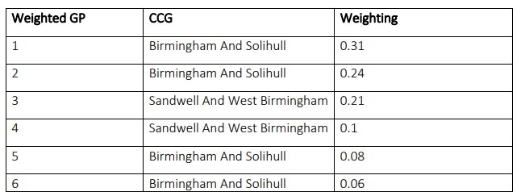
Example: Vertical Integration programme – example of synthetic unit for one treated GP
Notes:
which closely match the VI practice in terms of patient demographics, deprivation scoring, and disease outcomes, through numerical optimisation procedures
SC Practice – Weighted combination of donor practices
A lot of assumptions made – more to the methodology, beyond the scope of this presentation

Slide 22
Example: Vertical Integration programme
Construct a “synthetic” version of each of the 10 GP practices
For each VI practice, a “synthetic” control practice is constructed from donor practices across adjacent CCGs
The Synthetic Control practice represents the counterfactual scenario for the VI practice, where the intervention of becoming vertically integrated is assumed to never have occurred
Evaluate differences of three outcome measures:
1) Accident and Emergency Rates
2) Emergency Admission Rates
3) Emergency Readmission Rates
Aggregate effect sizes through pooled effects techniques
Notes:
which closely match the VI practice in terms of patient demographics, deprivation scoring, and disease outcomes, through numerical optimisation procedures
SC Practice – Weighted combination of donor practices
A lot of assumptions made – more to the methodology, beyond the scope of this presentation

Slide 23
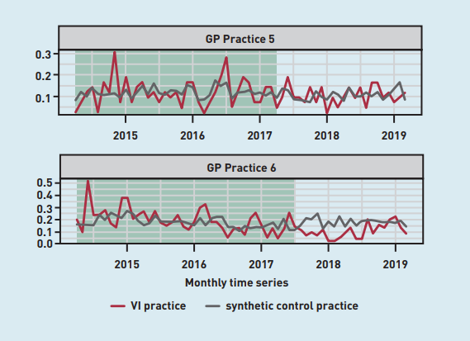
Example: Vertical Integration programme – VI and synthetic version of outcome
Comparing treated and synthetic units for one outcome
GP practice 5 – not significant
GP practice 6 – significant

Slide 24
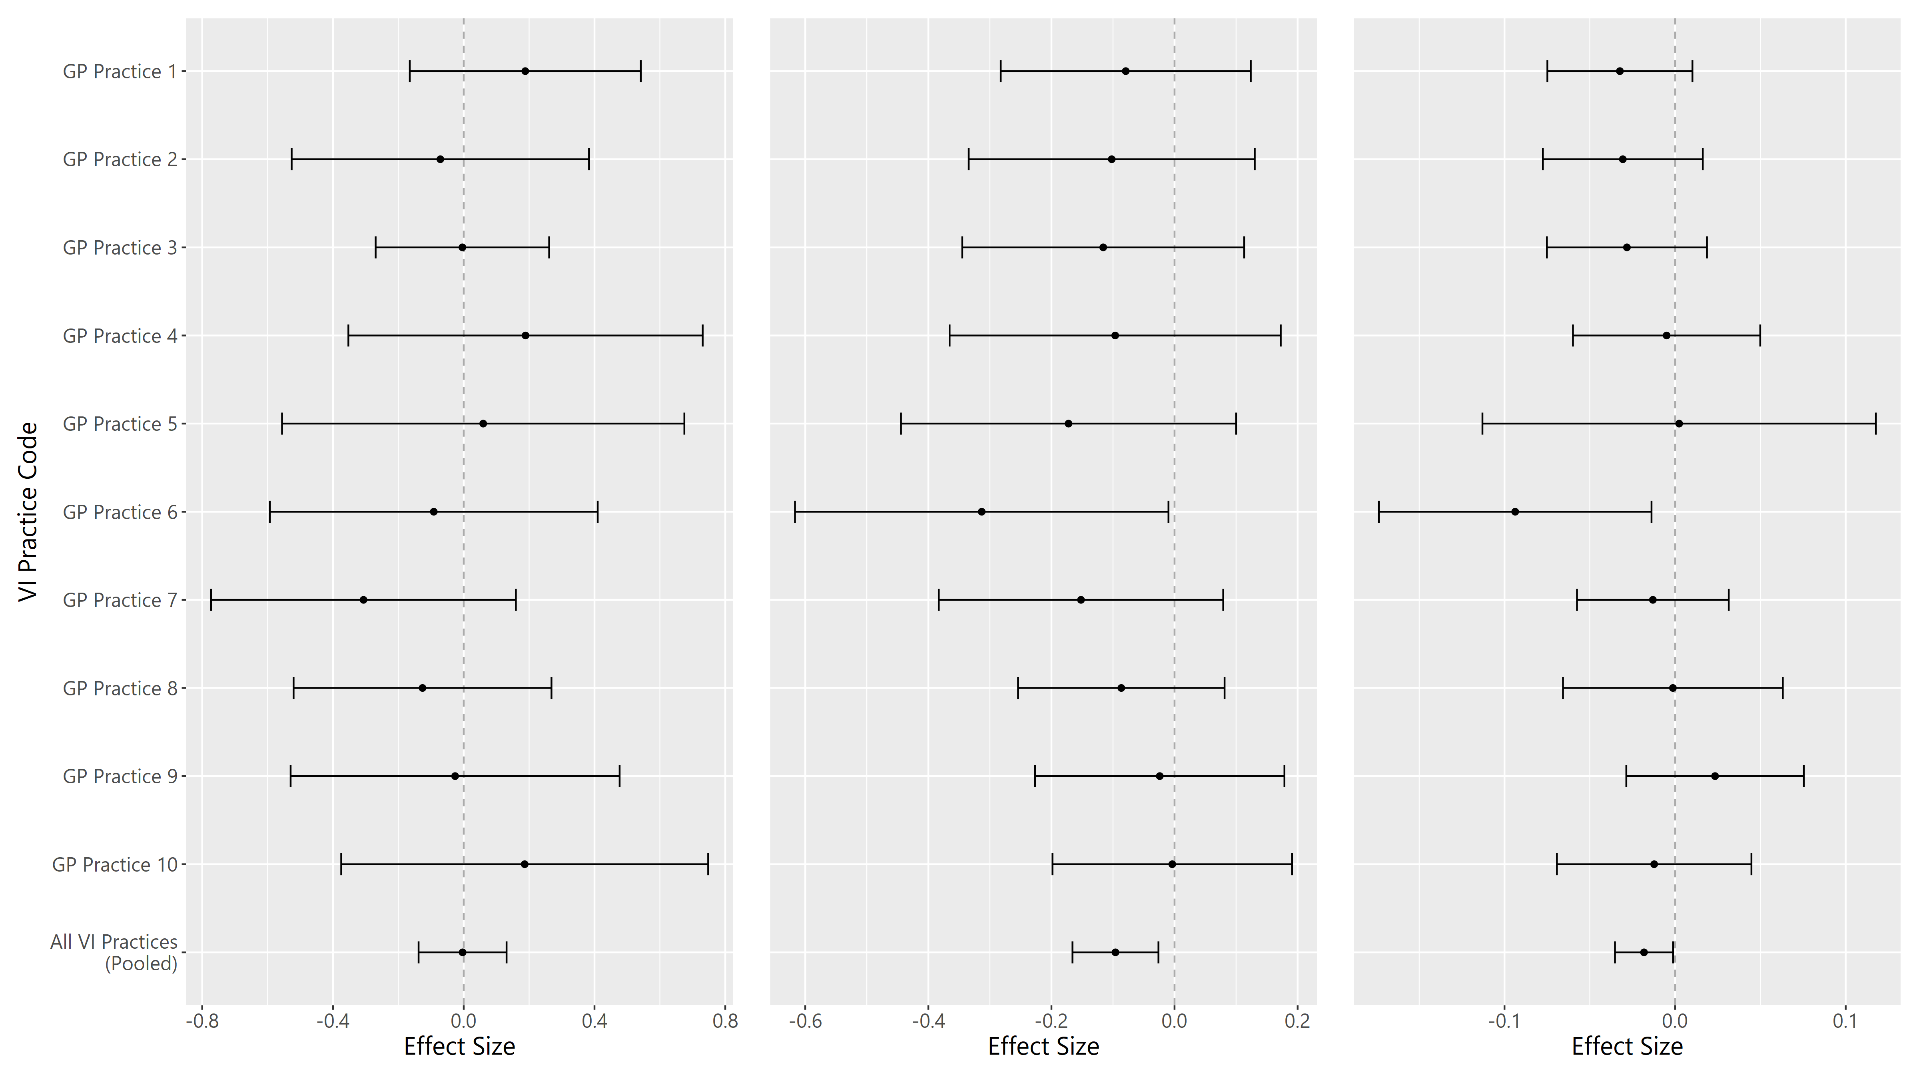
Example: Vertical Integration programme – results (effect sizes)
Change in rate of..
Accident and Emergency Attendances
Emergency Admissions
Emergency Readmissions
per month per 100 registered patients

Slide 25
Example: Vertical Integration programme – VI and synthetic version of outcome
Comparing treated and synthetic units for one outcome
GP practice 5 – not significant
GP practice 6 – significant
Notes:
There is currently no consensus on what constitutes a ‘good fit’ or how to judge similarity

Slide 26
Example: Vertical Integration programme – results (effect sizes)
Change in rate of..
Accident and Emergency Attendances
Emergency Admissions
Emergency Readmissions
per month per 100 registered patients

Slide 27
Example: Vertical Integration programme – results (effect sizes)
Change in rate of..
Accident and Emergency Attendances
Emergency Admissions
Emergency Readmissions
per month per 100 registered patients

Slide 28
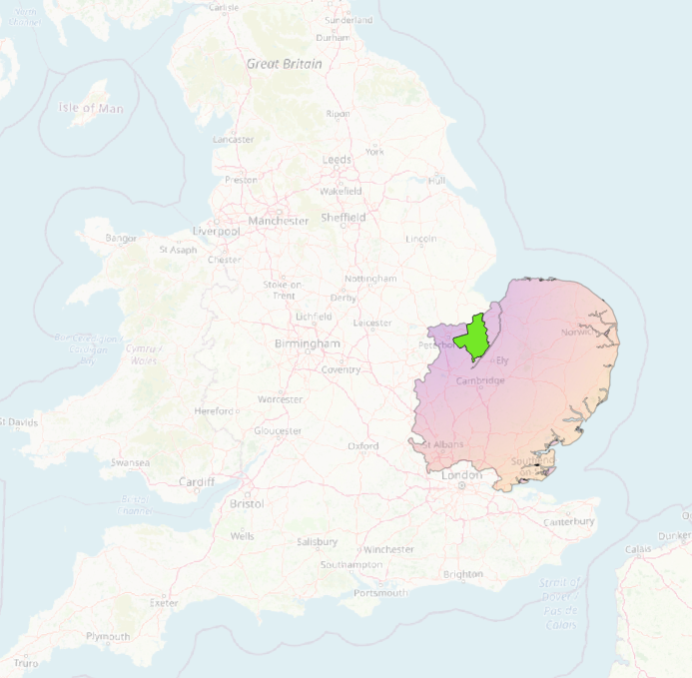
Tutorial
45 districts within East of England
Fenland district in Cambridge has the highest percentage of its adult population classified as overweight (+ obese) in the region (74.5%)
Fenland district council starts a mandatory military style bootcamp for all adults in 2020 to whip their population into shape, does it work?

Slide 29
Conclusions
Learning outcomes
What synthetic controls are
What they can be applied to
Previous examples
How to implement in R (relevant packages, functions)
SC has powerful applications to many intervention/case scenarios, but credibility depends on careful consideration of data requirements, selection of donor units, and contextual applicability
Notes:
Like all methods that draw causal inferences from observational data, SCM requires a number of assumptions and its applicability is limited by the requirement for series of outcome and covariate data on both the treated unit and a suitable pool of untreated comparison units.

Slide 30
Additional reading
Bouttell, J., Craig, P., Lewsey, J., Robinson, M. and Popham, F. (2018). Synthetic control methodology as a tool for evaluating population-level health interventions. J Epidemiol Community Health, [online] 72(8), pp.673–678. Available at: https://jech.bmj.com/content/72/8/673
good general introduction to SCs
Abadie, A. (2021). Using Synthetic Controls: Feasibility, Data Requirements, and Methodological Aspects. Journal of Economic Literature, 59(2), pp.391–425. Available at: https://www.aeaweb.org/articles?id=10.1257/jel.20191450
advanced, goes into the algebra behind the creation of the actual synthetic control
Seamer, P., O’Neill, S., Lloyd, T. and Conti, S. (2021). The long-term impacts of new care models on hospital use: an evaluation of the North East Hampshire and Farnham Vanguard programme. [online] The Health Foundation. Available at: https://www.health.org.uk/sites/default/files/2021-10/2021-iau_integratedcare_nehf.pdf
evaluation done last year using synthetic controls

Slide 33
Useful notes
The terms “treated” and “untreated” refer to units exposed and not exposed to the event or intervention of interest, respectively.
Synthetic controls can accommodate multiple “treated” units in the study – separate matched synthetic units are fitted.

Slide 34
Watch out for
Not suitable for small number of treated/control units – lead to biases, unsuitable fitting of pre-intervention trends
Units not sampled probabilistically during the falsification (placebo) tests, all units in the donor pool are ‘placeboed’ against
Consistent data quality, across the panelled time-series
Notes:
Limitations
Imputation, imperfect data, data not missing at random etc.

